Slide 1



Family Financial Education Series
Adult Session
April 17, 2021
Mrs. Betty Shepherd and Mrs. DurShawn Robinson
Sponsored by:

Slide 2
HOMEWORK
  Complete a budget giving every dollar a name and establish saving goals.
    https://mint.intuit.com/how-mint-works/budgets
    https://seedtime.com/10-free-household-budget-spreadsheets/
  List all debt with interest rate/monthly payment
    https://undebt.it/debt-snowball-calculator.php
  Request a FREE credit report
    www.annualcreditreport.com
  Play one game related to money as a family

Slide 3

AGENDA
Money Pitfalls and Debt
Understanding Interest Rates
Cosigning
Notes:
Spender vs saver how you identify self ……
Think about needs, wants and obligations
Conserve:
What can you get cheaper, or use less of?
Adjust:
What can you renegotiate?
Do without:
What can you eliminate?
Class participation – ask audience for ways they can save money – coupons, etc.?
BUDGET:
Working document
Easily identifies areas of overspending
Provides granular data
Helpful to visual learners
Prepares individuals for financial emergencies
Prepares individuals for periodic & irregular expenditures
May ease financial anxiety, worry & stress

Slide 4
DEBT REDUCTION (SNOWBALL)
Credit Card |  |  | Amount of Debt |  |  | Payment Per Month |  |  | # of Months to Pay
Card 1 |  |  |  | $ 500 |  |  | $ 50 |  |  | 10
Card 2 |  |  |  | $ 1,000 |  |  | $ 50 |  |  | 20
Card 3 |  |  |  | $ 1,200 |  |  | $ 50 |  |  | 24
Card 4 |  |  |  | $ 3,500 |  |  | $ 135 |  |  | 26
This chart shows the payments for the first thirteen months
1 | 2 | 3 | 4 | 5 | 6 | 7 | 8 | 9 | 10 | 11
50 | 50 | 50 | 50 | 50 | 50 | 50 | 50 | 50 | 50
50 | 50 | 50 | 50 | 50 | 50 | 50 | 50 | 50 | 50 | 100
50 | 50 | 50 | 50 | 50 | 50 | 50 | 50 | 50 | 50 | 50
135 | 135 | 135 | 135 | 135 | 135 | 135 | 135 | 135 | 135 | 135
This chart shows the payments until the total debt is paid
 | 14 | 15 | 16 | 17 | 18 | 19 | 20 | 21 | 22
1
2 | 100 | 100
3 | 50 | 50 | 150 | 150 | 150
4 | 135 | 135 | 135 | 135 | 135 | 285 | 285 | 285 | 285
Notes:
- Protect your credit score: Always pay off your balance, don't spend more than 30 percent of your limit, don't cancel a card you've had for a long time.
Credit score ! Credit Card !

Slide 5
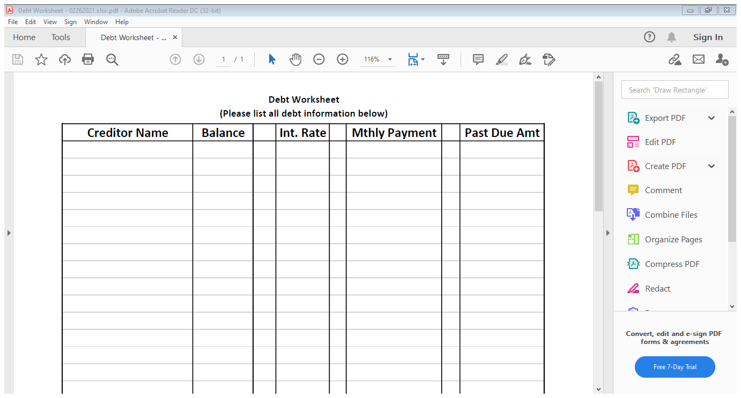
Debt Worksheet

Slide 6
Auto Loan Comparisons 72 vs. 60 Terms
Rating | Auto Loan Amount |  | Interest Rate |  | Monthly Payment |  | Terms | Total of Payments |  | Finance Charge
A | 20,000.00 |  | 2% |  | 313.30 |  | 72 | 22,557.60 |  | 2,557.60
C | 20,000.00 |  | 8% |  | 372.41 |  | 72 | 26,813.52 |  | 6,813.52
D | 20,000.00 |  | 16% |  | 460.73 |  | 72 | 33,172.56 |  | 13,172.56
F | 20,000.00 |  | 25% |  | 572.15 |  | 72 | 41,194.80 |  | 21,194.80
A | 20,000.00 |  | 2% |  | 372.29 |  | 60 | 22,337.40 |  | 2,337.40
C | 20,000.00 |  | 8% |  | 405.53 |  | 60 | 24,331.80 |  | 4,331.80
D | 20,000.00 |  | 16% |  | 486.36 |  | 60 | 29,181.60 |  | 9,181.60
F | 20,000.00 |  | 25% |  | 586.44 |  | 60 | 35,186.40 |  | 15,186.40
Notes:
* When you finish paying off your car, save the monthly payment as if you still have a car payment. ** Shop around for the best interest rates. *** Review your auto insurance premiums every three years to ensure you're paying the lowest possible rates. **** Never Co-Sign for anyone.

Slide 8

Financial
Wellness
Individual Counseling
Personal Finance Education
Tax Preparation Assistance
MAKING CHANGE INC.
www.makingchangecenter.org
Financial Counseling/Workshops
(443) 518-7646
Tax Assistance by Appointment Only
(443) 731-6398
@makingchangecenter.org
@makingchangectr
Notes:
We are at capacity
AARP
CASH CAMPAIGN
PG community VITA

Slide 9


Questions?
Notes:
Thank you for your time and attention.

