Slide 1
Gloria Washington Wallace Awards
The Gloria Washington Wallace Awards are annual awards given out by The Council of Elders to one male and one female student from the community of Black seniors in HCPSS who have met the criteria for the awards and have been recommended by the BSAP liaisons at their schools.
From the nominees, there is one male and one female student from each high school who have been named as the finalists for these awards.
Being nominated is a tremendous honor and we are proud of each and every one of you.

Slide 2
Gloria Washington Wallace Awards
In honor of Gloria Washington Wallace, founder of the BSAP Program, this award goes to one male and one female student where each have shown the greatest academic improvement over their high school career.
In addition, the student should also have demonstrated
how they used the 6 Ps:
Proud, Prepared, Prompt, Productive, Polite and Persistent
to overcome challenges to achieve their success
Here are our finalists !!

Slide 3
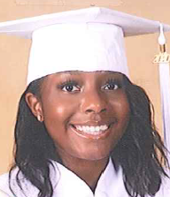
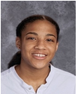
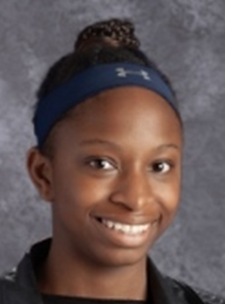
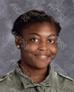
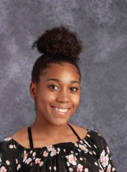
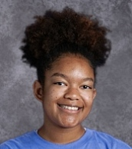
Gloria Washington Wallace Award Female Finalists
Niara Dula – Atholton
Deja Grissom – Centennial
Sophia Cichetti – Glenelg
Tiyonna Stokes - Hammond
Anii Harris – Howard
Michelle Britt – Long Reach
Montara Clay – Marriotts Ridge
Bria Trawally – Mt Hebron
Kamya Carter – Oakland Mills
Madison Chisholm – Reservoir
Ma’Nye Robinson – River Hill
Brittany Blakely – Wilde Lake
Congratulations to all of you !!

Slide 4
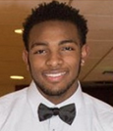
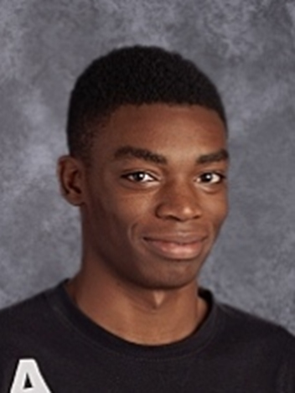
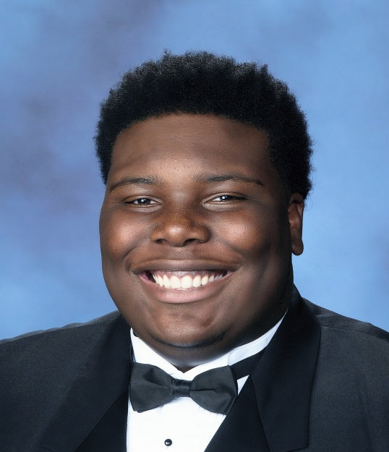
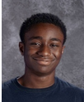
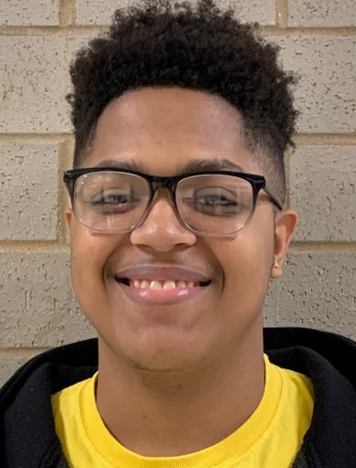
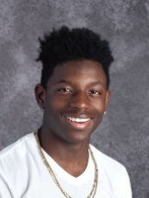
Gloria Washington Wallace Award Male Finalists
Jermore Kent– Atholton
David Ledbetter – Centennial
Jason Okorie – Glenelg
Jayden Freshwater – Hammond
Paul Ametepi - Howard
Jordan Reddix – Long Reach
Malachi Lee – Marriotts Ridge
Shamal Brown – Mt Hebron
Kai Castle – Oakland Mills
Michael Pope – Reservoir
Junior Amankwah – River Hill
Jarrett Monah – Wilde Lake
Congratulations to all of you !!

Slide 5
Gloria Washington Wallace Awardee
Achievements
The first award goes to a young lady who worked to lift her GPA up to a 3.21.
She persisted when challenges presented themselves, overcoming significant hurdles with just day to day life for her and her family.
She did not let those hurdles slow her down. In fact, she took on harder classes in school in an effort to raise her GPA and prepare for college. This young lady not only persevered, she excelled.
She did all this with a phenomenal attitude and serving as a role model for those around her.

Slide 6
MADISON CHISHOLM Reservoir High School

Slide 7
Gloria Washington Wallace Awardee Achievements
The second awardee is a young man who has demonstrated great resilience, strength, and character throughout his high school journey and persevered whenever faced with challenges.
Putting the needs of his family first severely impacted his grades early in high school. But he persevered and continued to work hard. His efforts paid off as he transformed his grades and raised them to a 2.5 GPA.
He played Varsity Football, was a church volunteer and maybe most valuable, a much-admired older brother.
His accolades include Student of the Month, Honor Roll and Alpha Achievers.
He has been accepted into several colleges across the country and plans to pursue an engineering career. We commend his hard work and enduring spirit.

Slide 8
SHAMAL BROWN Mt Hebron High School

Slide 9
Congratulations to all of our finalists
and to our winners.
We are very proud of all of you.
All of you will have finalist certificates
mailed to your homes.
Additionally, our two winners will have plaques acknowledging their award
along with a $100 Amazon gift card
sent to your homes.

