Slide 1
Money Tips for College Bound Seniors
May 22, 2021
Notes:
Sheree:
Welcome to the workshop Money Tips for College Bound Seniors hosted by the Howard County Public School System’s Office of Student Access and Achievement, The Council of Elders of the Black Community of Howard County and the Making Change Center. Congratulations, seniors! Graduations begin next week. My name is Sheree TIlley and I am the coordinator of the Office of Student Access and Achievement. I am excited to spend some time with you talking about money tips you will need to be successful in college and beyond. We are in a learning community. We learn from each other. We will ask for your participation.
If you don’t have it already, get a pen or pencil and take notes. Or use your device to take notes. The key to today’s workshop is taking notes.

Slide 2
Notes:
Sheree - We know that you may have participated in several online meetings; however, we want to provide you with a few workshop tips for everyone’s enjoyment today. During this session, we ask that you:
Mute your microphone until we ask for you to share.
Utilize the chat box throughout the session for questions and thoughts.
Raise your hand when we begin to ask questions and ask for your participation.
If you need to turn on the captions, it is located at the bottom of your screen.
Lastly, stay focused, be attentive, limit distractions, and engage in today’s important session.

Slide 3
Agenda
9:00 - 9:25 a.m. Welcome & Introduction
Sheree Tilley, Coordinator of Student Access and Achievement (HCPSS)
Towanda Brown, Chair of The Council of Elders of the Black Community of Howard County (TCOE)
Jasmine Brewer, Executive Director, MakingChange, Inc.
9:25 – 9:45 a.m. Financial Planning Tips
9:45 – 10:05 a.m. Avoiding Money Pitfalls
10:05 – 10:25 a.m. College Panel
Jordan Rogers, Florida A & M University
Nia Muhammad, Stanford University
Devin Powell, Bowie State University
10:25 - 10:30a.m Closing
Notes:
Sheree
Again, my name is Sheree Tilley and I am the coordinator of the HCPSS Office of Student Access and Achievement. Cohosting this experience for you is Towanda Brown (TCOE)...please unmute, wave and say hello. and Jasmine Brewer (Making Change Inc.) please unmute, wave and say hello.
Behind the scenes, we have Ashley Armstead Black Student Achievement Program Specialist. Please unmute, wave and say hello.
We have collaborated to provide you with ways to earn money, financial planning tips, and money pitfalls.
Following the presentation, you will have the opportunity to ask a college student a financial question. Our College panelists are Jordan. Please unmute, wave and say hello. Nia Muhammad Please unmute, wave and say hello. Devin Powell Please unmute, wave and say hello.
Our goal is to wrap up our session promptly at 10:30.

Slide 4
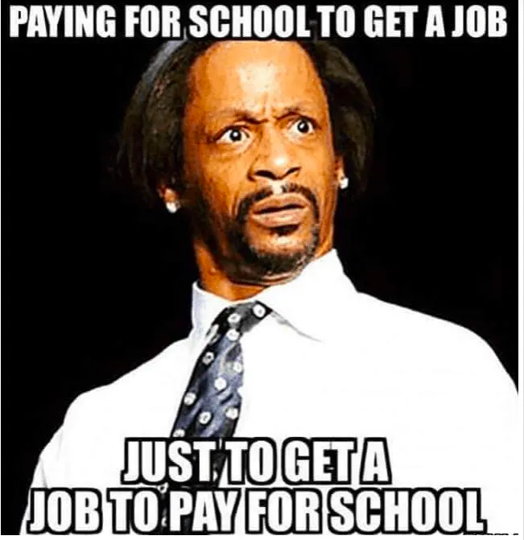
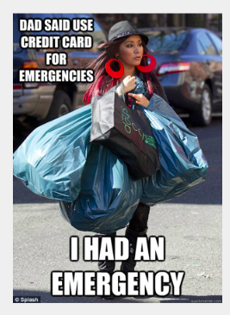
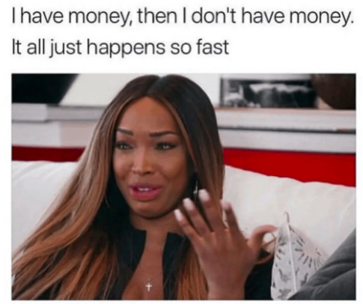
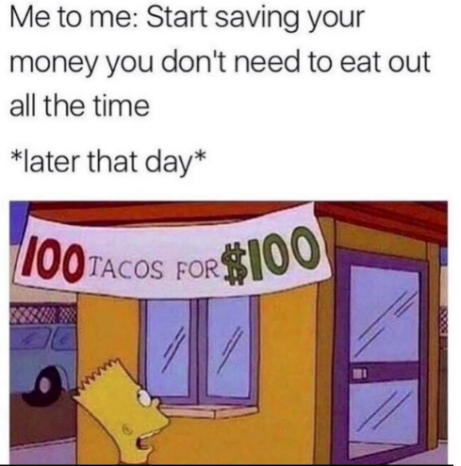
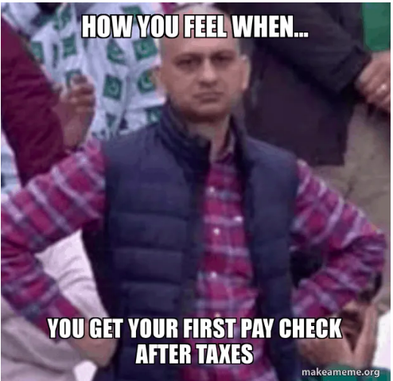
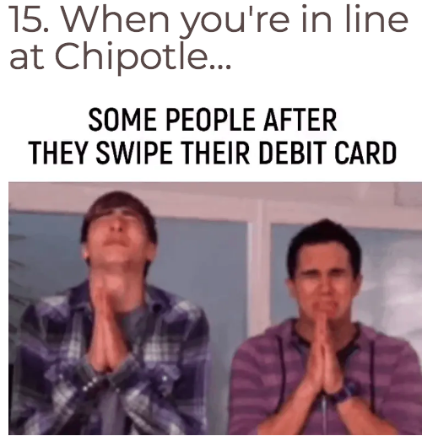
Setting the Stage
Notes:
Sheree:
Purpose of the workshop
*Feedback from a previous
*Passion of the planners
*Begin to empower you to close the generation wealth gap with tools of success. the earlier you start, the longer your money has to grow and gain compound interest.
Who is in the room? Name colleges represented.
Share my brief financial story.
Name your money theme song
Money, Money, Money - O’Jays
Have you heard of these terms or phrases?
Broke college student
Money doesn’t grow on trees
Do you have McDonald’s money?
It’s time to tighten the belt.
Don’t spend it all in one place.
Do you think I am made of money?
Closed mouths don’t get fed and lazy hands don’t count bread.
People first, then money, then things
Poll Question: What are you currently doing to make money?

Slide 5
Ways to Earn Money Right Now
Entrepreneurship
Howard County Recreation and Parks or any local camp
College campuses
Movie theater cashier or usher
Front desk receptionist
Yard worker or landscaping
Pet sitter or dog walker
Babysitter
Tutor
Grocery and other store associate
Trunk party, going away party, etc.
Google it!
Notes:
Sheree:

Slide 8
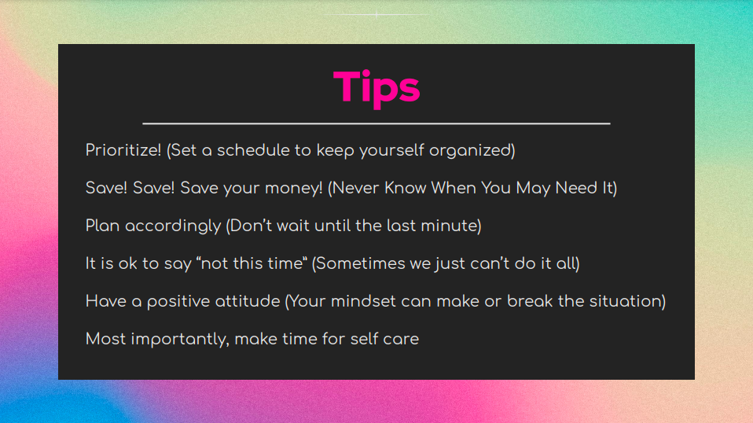

Slide 10
Ways to Earn Money in College
Scholarships
Work Study (part of a financial aid package)
Entrepreneurship
Career Development Center on campus
Internships
Jobs on campus, in the community, government, etc.
Temporary Employment Agency
Tutor, become a teacher’s assistant, research assistant, virtual assistant
Resident advisor or resident assistant
Sell your old textbooks or rent your textbooks
Write resumes, essays
Sell or rent your unwanted or unused items
Cashapp investing or other apps
Howard County Public School System
Google it!
Notes:
Sheree:
Scholarship Opportunities:
Naviance
Local community organizations: Howard County arts council, Continentals, greek organizations,
College campus
Fastweb
Scholarship360
Affinity Group Scholarships: United Negro College Fund (UNCF), NAACP National Association for the Advancement of Colored People, etc
Your parents jobs, credit card company, 401k or 403b company, your bank or credit union, your job, grocery stores, fast food restaurants, Khols, etc. Where you patronize probably has a scholarship available.
What do I do with the money I earn? I am glad you asked.

Slide 11
Financial Planning Tips to Aid in College Success
Choose a career that will stand the test of time
Be careful about Return on Investment (ROI) even with your major
Take classes about financial strategies and investments
Start a habit of saving, wealth is a mindset
Value money and its potential, $5 a day adds up to $1,825 per year
Avoid accumulating debt, if you acquire and use credit cards, pay them off
When employed, participate in money-matching opportunities at work
401k matched percentages
Obtain a financial mentor or counselor
Notes:
Towanda:

Slide 12
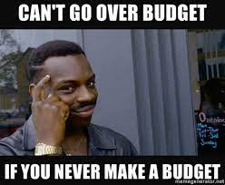
Balancing Your Budget
Notes:
Towanda:

Slide 13
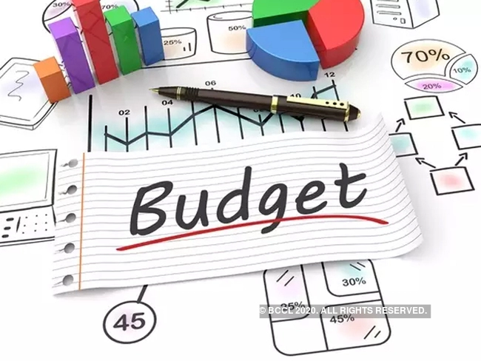
What Is a Budget and Why Is It Needed?
A good budget provides a framework for financial stability & success and helps you live within your means.
Helps to distinguish wants vs needs
Helps to reduce reliance on credit
Helps to start a habit of savings
Notes:
Towanda: A budget is a foundation/framework to financial success. With COVID, spending money has become difficult because it is invisible: online shopping, internet banking

Slide 14
What is Included in a Budget?
Income – List all sources of income each month and throughout the year (Monies Earned, Birthday Gifts, Christmas Gifts, etc.)
Expenses –
Fixed Expenses – List all expenses that stay the same every month (rent/mortgage, insurance, loans, utilities, mobile phones, cable, savings, etc.)
Flexible Expenses – List all expenses that vary from month to month (gasoline, groceries, car repairs, dry cleaning, home repairs, etc.)
Discretionary Expenses – List all expenses that are primarily wants as opposed to needs (entertainment, eating out, gifts, personal care, vacations, contributions, etc.)
Notes:
Towanda: Discretionary expenses has a lot to do with wants versus needs. Is a cell phone a need or a want?

Slide 15
HOW MANY OF YOU...
Have a budget?
Have an account?
Save money?
Notes:
Towanda:

Slide 16
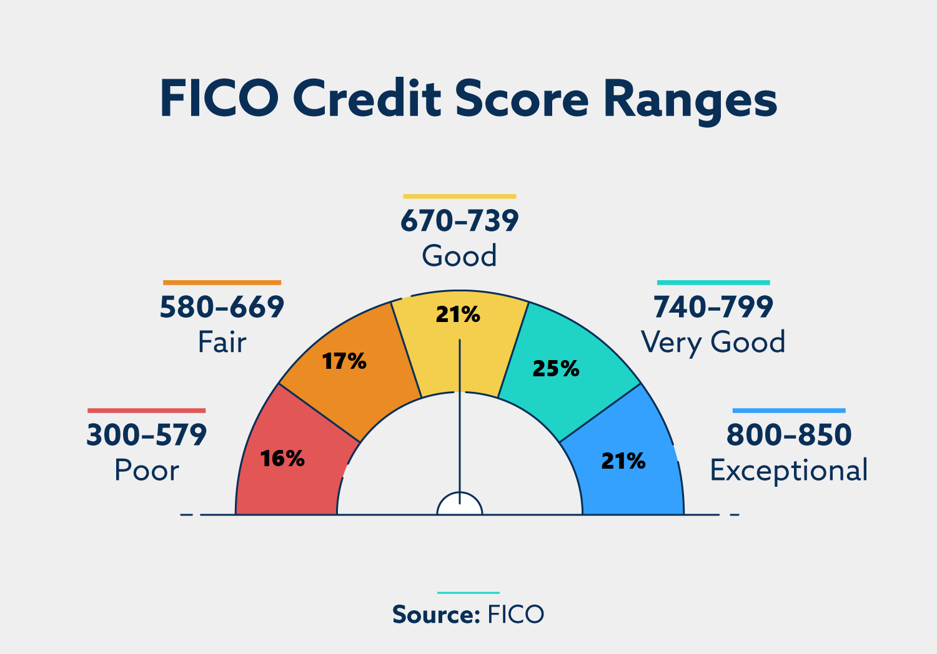
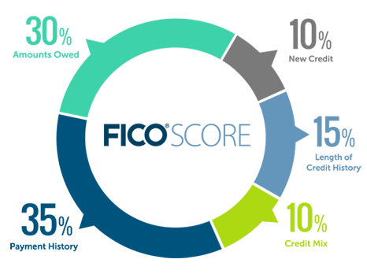
Credit Scores – Do You Know Yours?
Notes:
Towanda:

Slide 17
What Does Credit Affect?
Interest rates for credit cards, car purchases and home purchases
Ability to secure an apartment
Ability to get a job (affects acquiring a clearance, even public trust, for the federal government)
Credit provides an easy pathway to impulsive buying:
Individuals using credit are often willing to spend twice as much money for the same exact item because using credit cards as opposed to cash clouds our judgment and we often spend more than planned.
Notes:
Towanda:

Slide 18
Top Money Mistakes
Credit
Ruining credit score
Racking up credit card debt
Spending more than you can afford
Student Loans
Borrowing too much
Misuse of student loan money
Not understanding repayment of loans and entering default status
Stopping the scholarship search
Budget
Not using one!
Notes:
Jasmine:

Slide 19
Credit
Ruining their credit score
Racking up credit card debt
Carrying high balances month-to-month
Spending more than you can afford to pay back
Photo credit: https://www.youtube.com/watch?v=TILzwGy0PYs
Notes:
Jasmine:
Annualcreditreport.com offers free weekly credit reports (no scores); this has been extended another year through April 2022. Get comfortable checking your credit report, knowing what’s there and understanding information included on the report. This is going to be CRITICAL to your ability to use credit to your benefit in the future.

Slide 20
Notes:
Jasmine:

Slide 21
Student Loans
Borrowing too much
Misuse of student loan money
Not understanding repayment of loans and entering default status
Stopping the scholarship search
Photo Credit: https://blog.harvardlawreview.org/for-profit-schools-predatory-practices-and-students-of-color-a-mission-to-enroll-rather-than-educate/
Notes:
Jasmine:

Slide 22
Student Loan Debt
Notes:
Jasmine:
Source: https://www.credit.com/personal-finance/average-student-loan-debt/

Slide 23
Notes:
Jasmine:
Perkins loan - low interest loan to help needy students finance the cost of post secondary education.
FFEL - Federal Family Education Loan (Stafford, Unsubsidized Stafford, PLUS)
Direct - loan directly from the Dept of Education.

Slide 24
Budgeting
Create a spending plan that works for YOU
Organize your expenses and income
If you don’t have the money on hand to spend, do not make the purchase
Use cash – this will help you determine if the purchase is a NEED or a WANT
Pay yourself first – SAVE!
Notes:
Jasmine:

Slide 25
Beware of Scams!
If it sounds too good to be true, it probably is!
Be mindful of where and who you share your personal information with
When purchasing items online using a credit or debit card, ONLY use your personal computer and order from reputable companies
Stopping the scholarship search
Photo Credit: https://blog.harvardlawreview.org/for-profit-schools-predatory-practices-and-students-of-color-a-mission-to-enroll-rather-than-educate/
Notes:
Jasmine:
Mention sous sous/pyramid schemes; “get rich quick” schemes.
Be sure to ask a trusted adult/your parents before sharing your personal information and/or giving money with promises that you will “get rich” quickly.
When ordering online, be aware that your information could be hacked giving someone access to your bank and/or credit card accounts; another reason to regularly check your credit report - monitor any unusual activity.

Slide 26
Budgeting Recap
5 Budgeting Tips for College Students that can Help Set You Up for Financial Success
Calculate your net income
List monthly expenses
Organize your expenses into fixed and variable categories
Determine average monthly costs for each expense
Make adjustments
Notes:
Jasmine
5 Budgeting Tips for College Students (cnbc.com)

Slide 27
Ask a College Student
Panelists
Jordan Rogers, Florida A & M University
Nia Muhammad, Stanford University
Devin Powell, Bowie State University
Notes:
Sheree:
Panelists - State your name, if you attended an HCPSS school, college you are attending and one major money tip you’ve learned.
We will now take questions from our audience. If you have a question, place it in the chat or click the raise your hand button. Ashley will man the chatbox for questions and I will focus on raised hands to select participants.
Ashley, would you stop presenting your screen please?

Slide 28
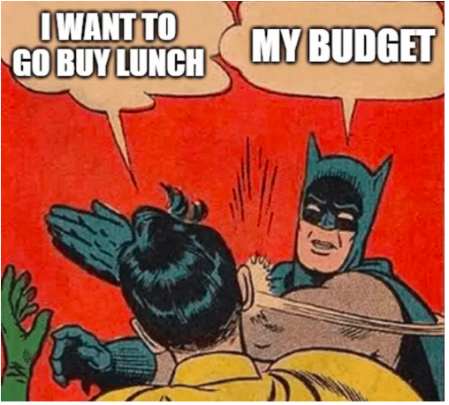
What’s Next?
Feedback Form
TCOE https://www.thecouncilofelders.org/
Making Change Center
https://makingchangecenter.org/
Email with Resources
Notes:
Towanda

