Slide 1
Financial Family Series: Budget Basics
Middle School Session
April 17th, 2021

Slide 2
Introductions
Mary Samokhvalova
12th Grade
Applications & Research Laboratory: Academy of Finance II

Slide 3
Roadmap for Today
Homework Review
Interest Rates
Money Pitfalls
Budgeting/Banking

Slide 4
1. Homework Review
Financial/Personal Goal

Slide 5
Drop your personal/financial goal in the chat. Make sure it is
SMART!
Specific
Measurable
Attainable/Achievable
Relevant/Realistic
Timely/Time-bound

Slide 6
Sample SMART Goal
I want to save $50 of my birthday gift money by April 24, 2021 (two days after my birthday). Why? To save for a new phone.

Slide 7
2. Interest Rates
They affect your finances!

Slide 8
What are interest rates?
Interest rate: money a lender charges a borrower
You lend money to a bank through a checking account
Bank pays you money for storing with them
Calculated ANNUALLY

Slide 9
Interest Rate Example
Invest $100
Interest rate is 5%
100*1.05 = $105
0.05 = 5%
You made $5 in 1 year just by saving in a checking account!

Slide 10
Why Should YOU Care?
Higher interest rate = you make more money
Interest rates can change
Money you make can fluctuate
Interest rates apply to loans too
Credit cards
Mortgages
Student loans

Slide 11
3. Common Money Pitfalls
Avoid these!

Slide 12
QUESTION:
What is a BAD way of using your money?

Slide 13
Things you SHOULDN’T do with money
Spend more than you have (debt)
Go over your credit card limit
Buy things that you might not need or even use

Slide 14
How to Avoid Money Pitfalls
Set goals
-How much can I spend? How much can I save?
Budget (more on this later)
Save
Invest (with parental permission)

Slide 15
4. Budgeting
How to manage your money

Slide 16
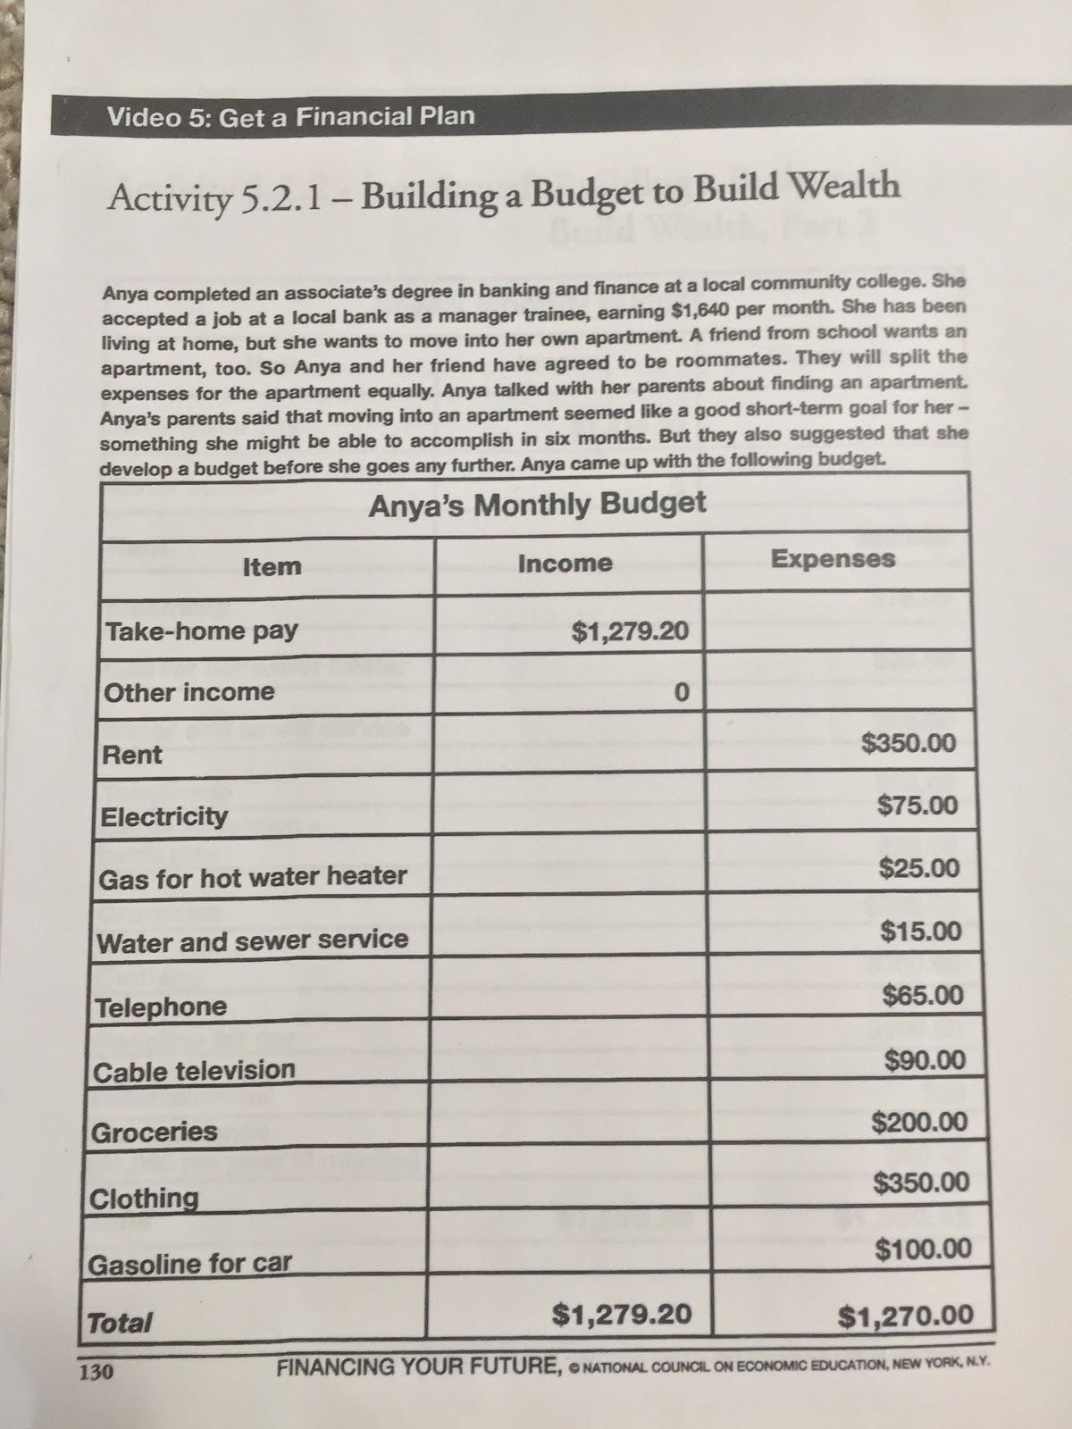
A recent graduate’s budget
A recent graduate’s budget
A Recent Graduate’s Budget

Slide 17
A recent graduate’s budget
A recent graduate’s budget
Answer these Questions...
How are her expenses?
How are her savings?

Slide 18
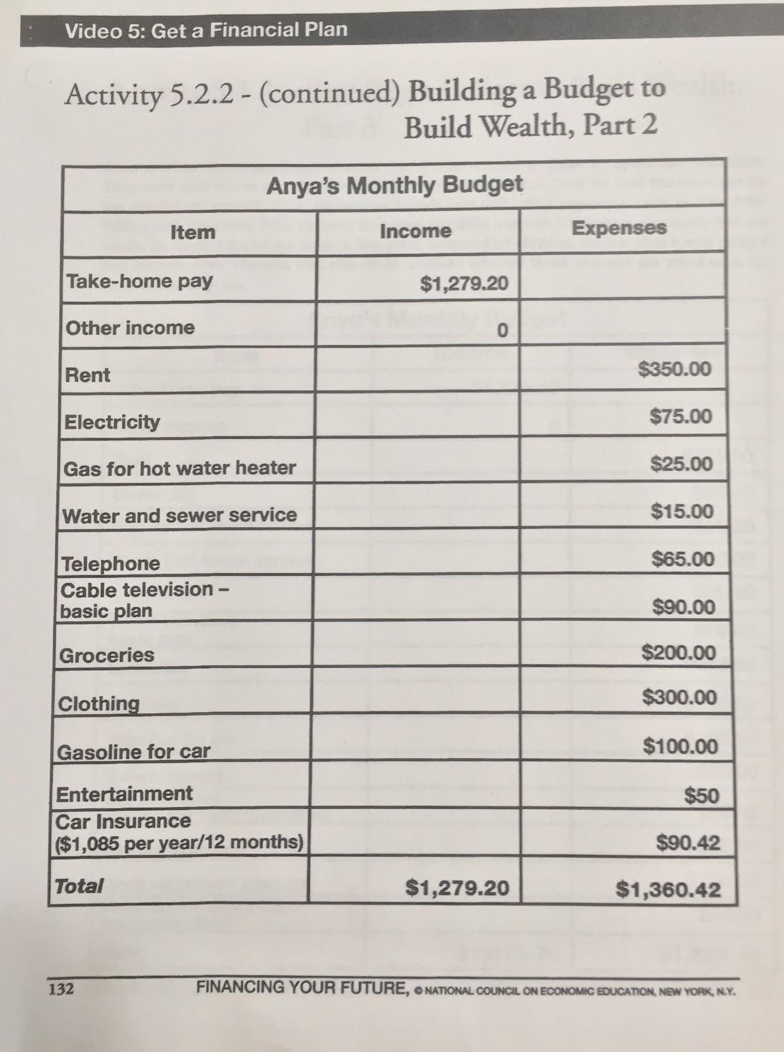
She made a change. Now what?
What change did she make?
Check out the total… what would you suggest?

Slide 19
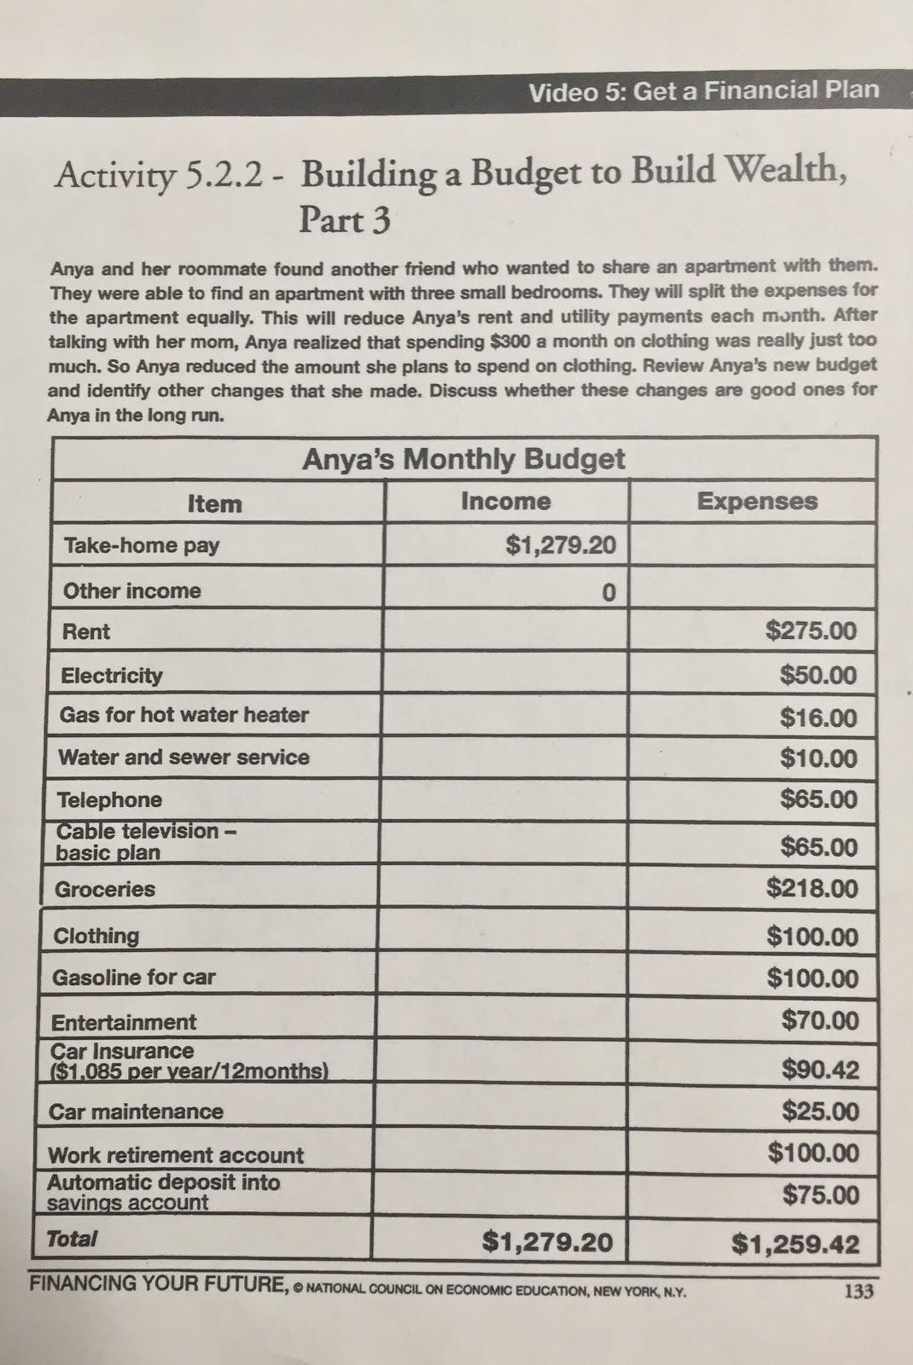
More Revisions
What do you think now?

Slide 20
Budgeting Takeaways
Add up your income (what you get)
Add up your expenses (what you spend)
Should have “wiggle room” for emergency expenses
Make room for saving/investing

Slide 21
5. Banking
Safeguarding your money

Slide 22
What is a bank account?
Stores money
Gives interest
Come in many types

Slide 23
Why use a bank account?
Makes you money
Safe
Helps with budgeting

Slide 24
Types of Bank Accounts
Checking accounts
Good for quick cash/day to day expenses
Saving accounts
Better for long term

Slide 25
Be Careful About...
Fees
Withdrawal limits
Security
Trust
Inflation

Slide 26
QUESTIONS?

Slide 27
Which is the Better Bank?
Dandelion Bank has online banking, a $5 withdrawal fee, and a 1.2% interest rate.
Rosebud Bank has online banking, a $5 withdrawal fee, and a 1.0% interest rate

Slide 28
Dandelion Bank is the better bank
Higher interest rate: 1.2% > 1.0%

Slide 29
Which is better for short/long term?
Dandelion Bank now has:
-no online banking
-withdrawal fee of $20
-withdrawal limit of $100
-interest rate of 5%
Rosebud Bank now has:
-online banking
-withdrawal fee of $5
-withdrawal limit of $1,000
-interest rate of 2.5%

Slide 30
You Could Use Both Banks!
Dandelion: better for long term
Lower withdrawal limit
Higher interest rate
Rosebud: better for day to day
Higher withdrawal limit
Lower withdrawal fee

Slide 31
QUESTIONS?

Slide 32
THANK YOU!
Remember these tips and good luck with your financial future!

Slide 33
Credits
Presentation template by SlidesCarnival
Photographs by Unsplash

