Slide 1
SANKOFA AWARDS
In reverence to a legacy of fighting for equitable education, TCOE has consistently sought to celebrate and commemorate academic success by Black students in the Howard County Public School System. One of the most prestigious of awards is the Sankofa Award and is bestowed annually upon two students (male and female) who have done the following:
Demonstrated the highest levels of achievement in academic performance,
Served in leadership in their school and community,
Also showed significant achievement in non-academic areas, and
Represented themselves and others with the qualities of good character.
These students are shining examples of the quality of our young Black Scholars here in Howard County.

Slide 2
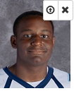
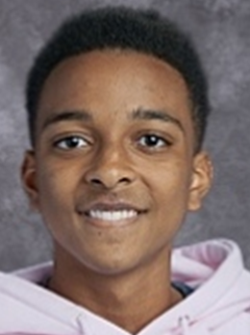
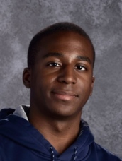
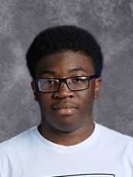
Sankofa Award - Male Finalists
Clifton Cunningham II – Atholton
Darian Avery – Centennial
Raja Ukondwa – Glenelg
David Aodu – Hammond
Collin Greene – Howard
Michael Maiden – Long Reach
Kwabena Aduse-Poku, Jr. – Marriotts Ridge
Gabriel Bekele – Mt Hebron
Peyton Thomas – Oakland Mills
Jonathan Marter – Reservoir
Gabriel Lancaster-Dixon – River Hill
Zion Olibris – Wilde Lake
Congratulations to all of you !!

Slide 3
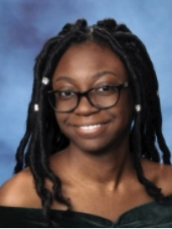
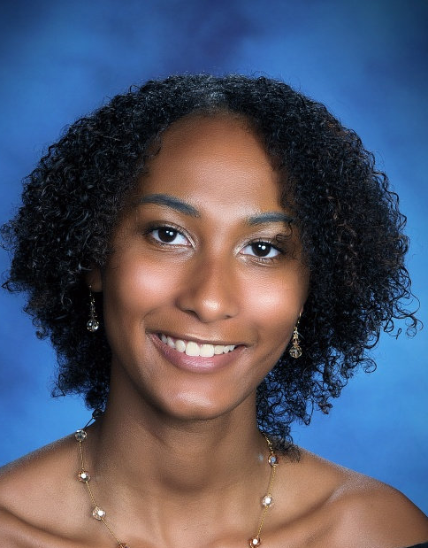
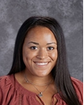
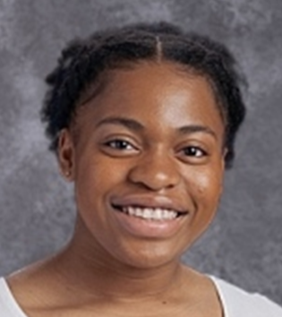
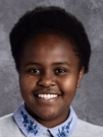
Sankofa Award - Female Finalists
Emma Brown – Atholton
Noni Grimes – Centennial
Juanita Mackey – Hammond
Skye Swann – Howard
Rayna Livingston – Long Reach
Leena Khalifa – Marriotts Ridge
Tolulope Ajaye – Mt Hebron
Kiana Macharia – Oakland Mills
Esther Ayoade – Reservoir
Chelsea Baker – River Hill
Melody Simmons – Wilde Lake
Congratulations to all of you !!

Slide 4
Sankofa Awardee Achievements
The first Sankofa Award goes to a young man who has chartered his way to a weighted GPA of 4.69 and scored a 1490 on his SATs.
In his high school career, he took on the challenge of 11 Advanced Placement classes along with 8 G/T Classes.
He is a member of the National Honor Society, National Math Honor Society and National Science Honor Society.
He demonstrated tenacity and leadership as the Captain of his Varsity Football and Track teams while also serving as the Captain of the JROTC corps
He was Captain of the Academic Bowl team, and Membership Chair of the Alpha Achievers.
He has garnered acknowledgement from members of the U.S. House of Representatives and the U.S. Senate for his overall success and has earned the highest levels of recommendation to attend the United States Naval Academy where he intends to embark upon a career as a U.S. Naval Officer in service to his country.

Slide 5
COLLIN GREENE Howard High School

Slide 6
Sankofa Awardee Achievements
The second and final award goes to a young lady who has been more than a stellar scholar with an impressive 4.83 weighted GPA.
In her high school career, she has taken 11 Advanced Placement courses and received an A in every single one.
She is a member of National Honor Society and has received awards for excellence in computer science.
As a student citizen, she has worked to combat hunger, served as a peer counselor, was Co-President of Delta Scholars and Secretary of the Student Government Association.
As an athlete, she was Co-Captain of the Varsity Soccer team and Captain of both the Indoor and Outdoor Track teams.
She scored a 1530 on her SATs and has been accepted into several prestigious universities where we expect her to continue her success.
In her words, she used her tools to compose a blueprint for how to lead her life.

Slide 7
CHELSEA BAKER River Hill High School

Slide 8
Congratulations to all of our finalists
and to our winners.
We are very proud of all of you.
All of you will have finalist certificates
mailed to your homes.
Additionally, our two winners will have plaques acknowledging their award
along with a $100 Amazon gift card
sent to your homes.

